Slide 1


Slide 2



RESTAURANT
MANAGEMENT
SYSTEM
JANHAVI SHARAD SHEDGE-287

Slide 3
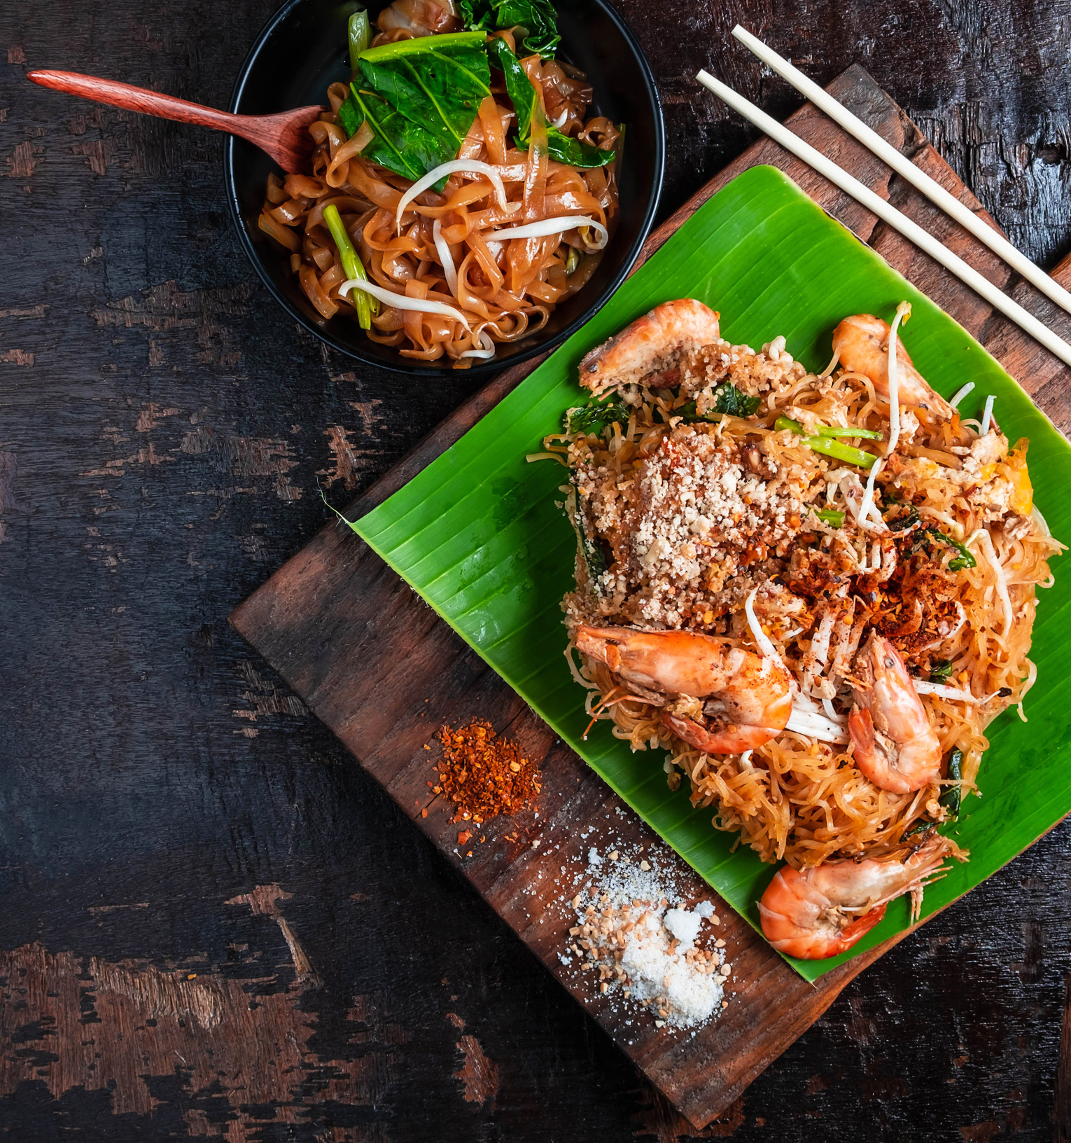
TABLE
OF CONTENT
01. INTRODUCTION
02. PROBLEM STATEMENT
03. ADVANTAGES
04. DISADVANATGES
05. FUTURE SCOPE

Slide 4
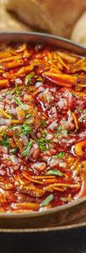
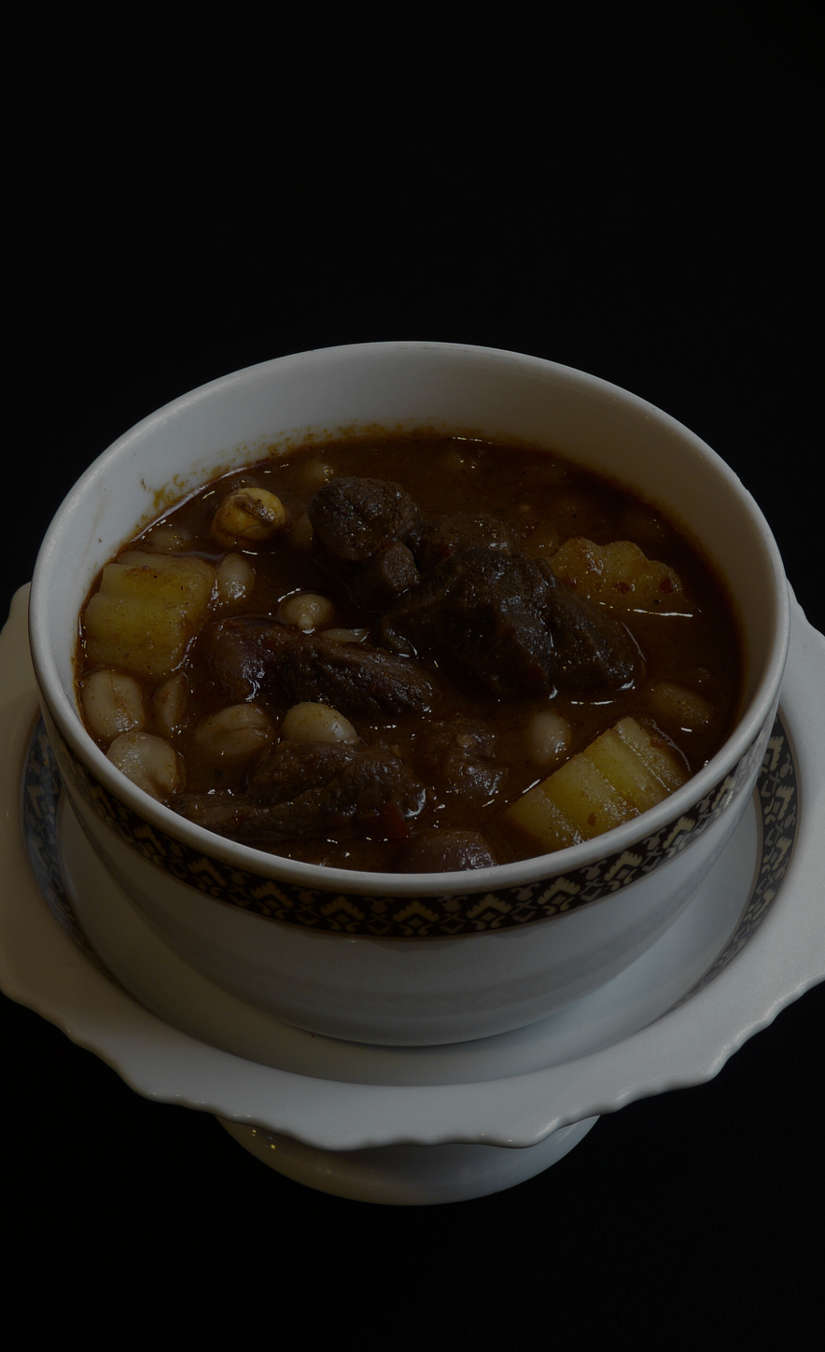
INTRODUCTION
Shambhavi Restaurant Management System requires users to create an account to order food. Users need to provide a unique username, email, new mobile number, and password for account creation, along with their delivery address. Once logged in, users can browse through different food categories such as soups, starters, main course dishes, and desserts. They can then search for specific food items of interest and select the ones they want to order. After selecting their desired meals, users can place their order and confirm their delivery address.

Slide 5
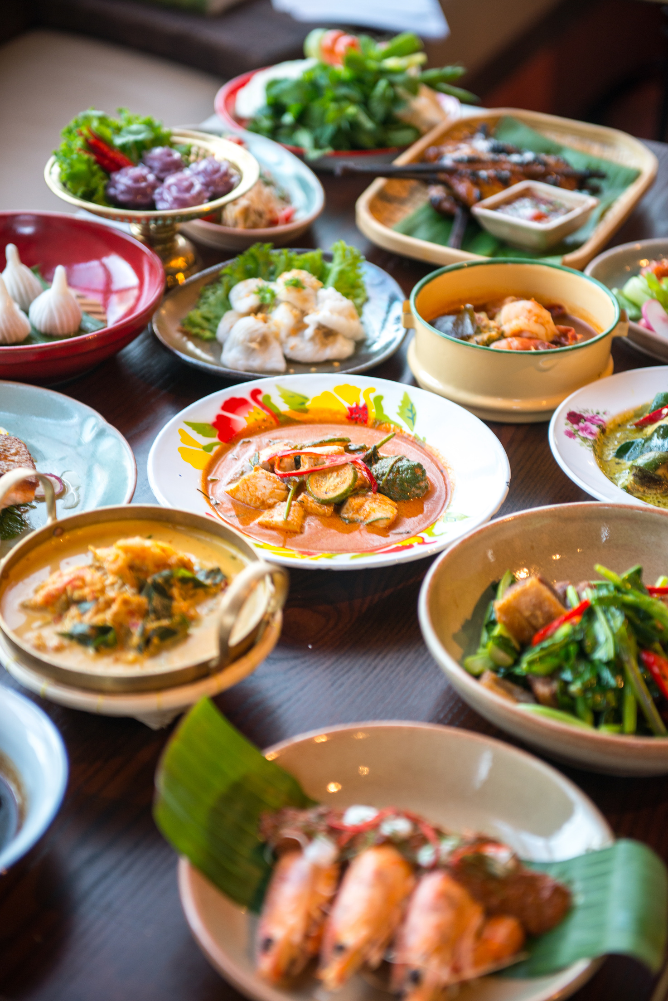
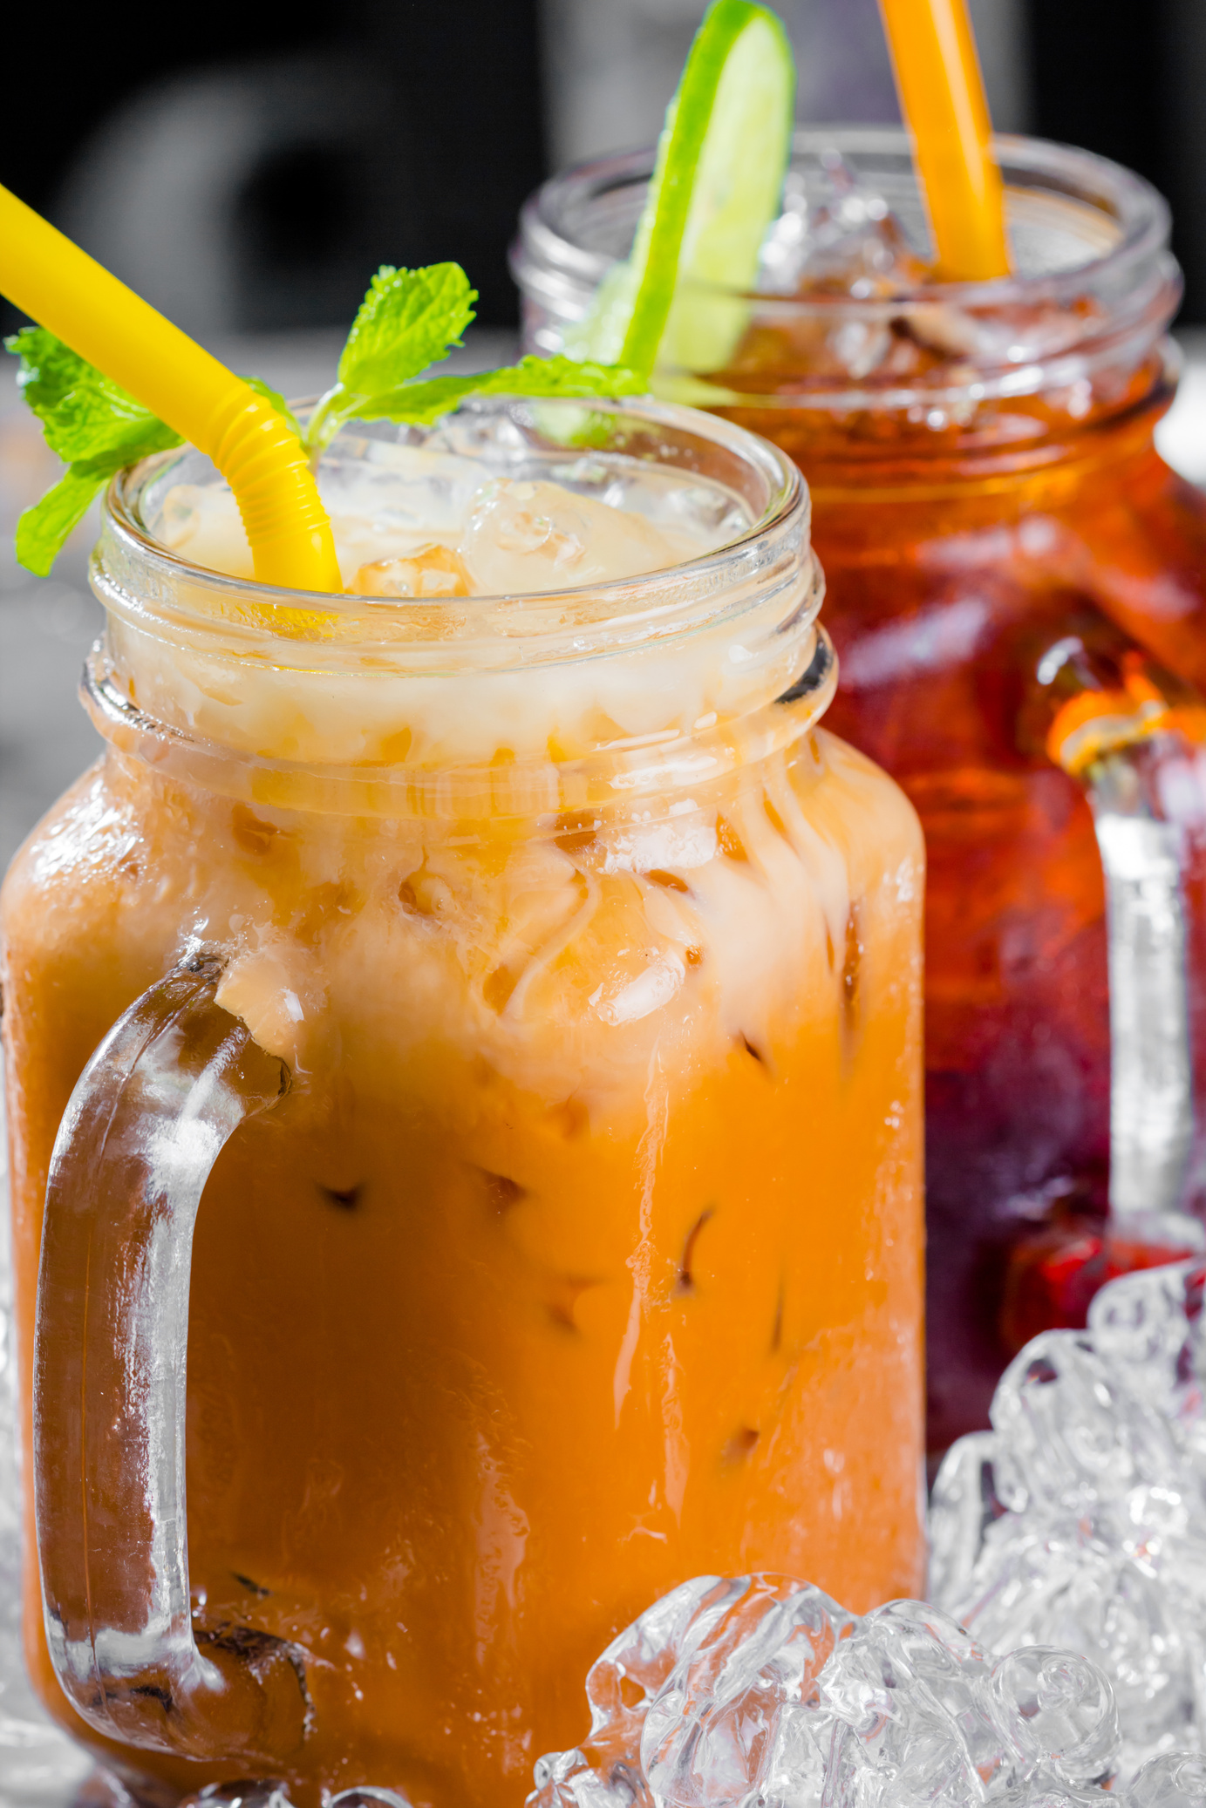
PROBLEM STATEMENT
➢Shambhavi Restaurant lacks a website, missing out on showcasing its offerings and crucial information online.
➢Dependency on manual order-taking leads to errors, delays, and diminished customer satisfaction
➢The restaurant's inability to engage with customers digitally hampers feedback collection and service improvement efforts.
➢Manual tracking of orders and supplies increases costs and reduces operational efficiency.
➢Customers struggle to find basic information like menus and hours online, reducing the likelihood of restaurant visits.

Slide 6

ADVANTAGES
➢ By requiring users to create an account, the system can offer personalized services, such as order history tracking and customized recommendations, leading to improved customer satisfaction.
➢ Having users create accounts allows the system to store their preferences and past orders, reducing the likelihood of errors during the ordering process and ensuring orders meet customer expectations.
➢ Categorizing food items and providing search functionality simplifies the ordering process for users, making it easier and faster to find and select desired items, leading to increased order placement and revenue generation.

Slide 7

DISADVANTAGES
Current limitations include manual customization of food orders, manual location updates for orders, and limited payment options. Additionally, the inability to save payment details for future use and process orders as a guest may inconvenience users. However, future enhancements such as integrating Google Maps for automatic location updates, adding various payment options, and improving website design and search functionality aim to address these drawbacks and enhance the overall user experience.

Slide 8
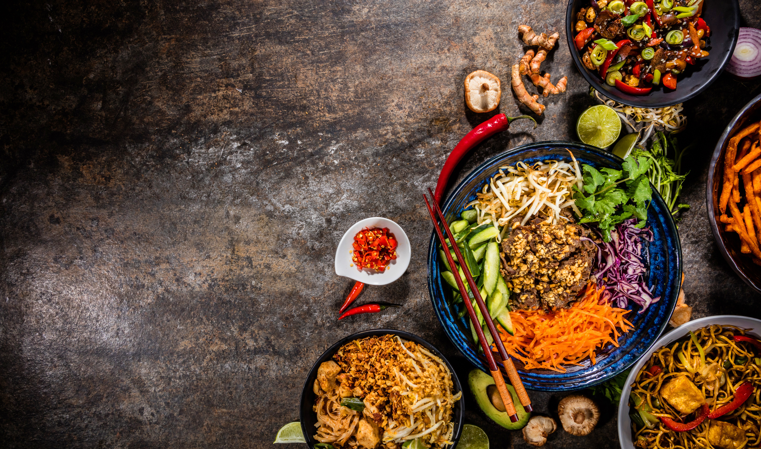

FUTURE SCOPE
➢ Allow customers to customize food orders
➢ Implement automatic location updates for orders using Google Maps integration to streamline order management on the restaurant website.
➢ Payment Options: Add different payment options such as PayPal, Cash, Gift Cards etc.
➢Allow to save payment details for future use.
➢ Allow to process an order as a Guest
➢Continuously improve website design and search functionality to enhance user experience.

Slide 9
THANK YOU

